Slide 1
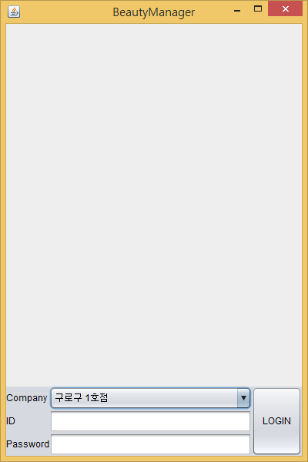
로그인화면(LoginDlg)

Slide 2
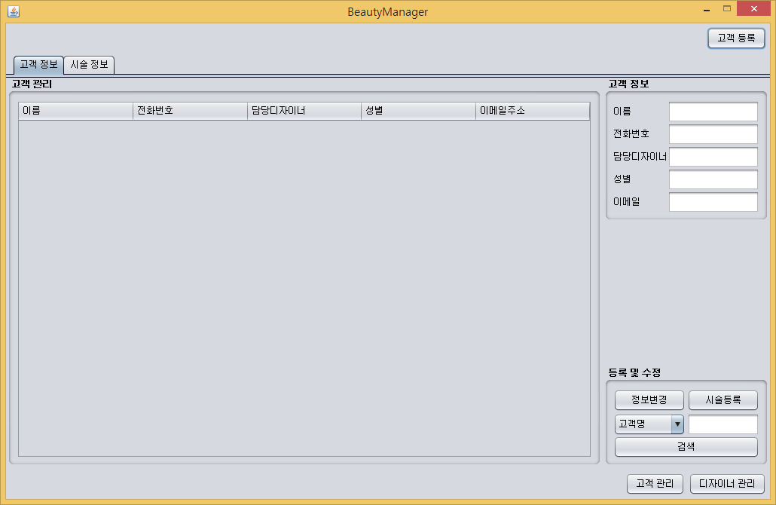
메인화면(BMMain)

Slide 3
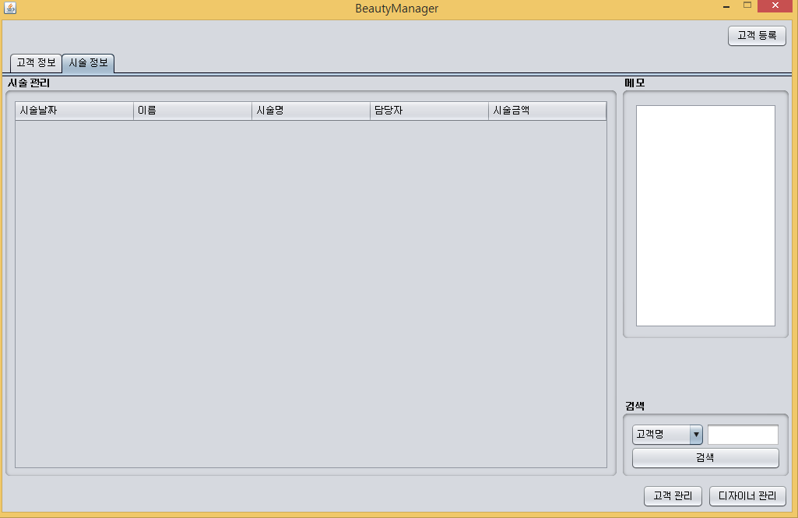
고객시술확인 Panel(BMCustomerDesign)

Slide 4
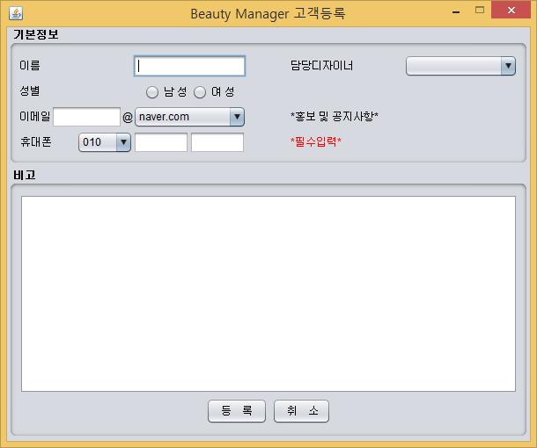
고객등록 화면(BMCutomerJoin)

Slide 5
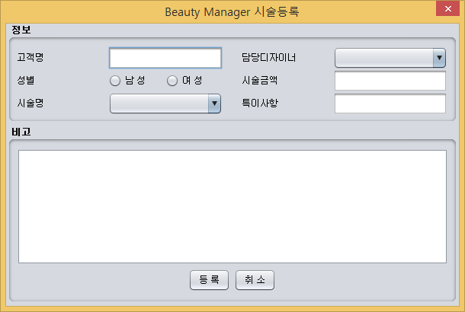
시술등록화면(BMDesignJoin)

Slide 7
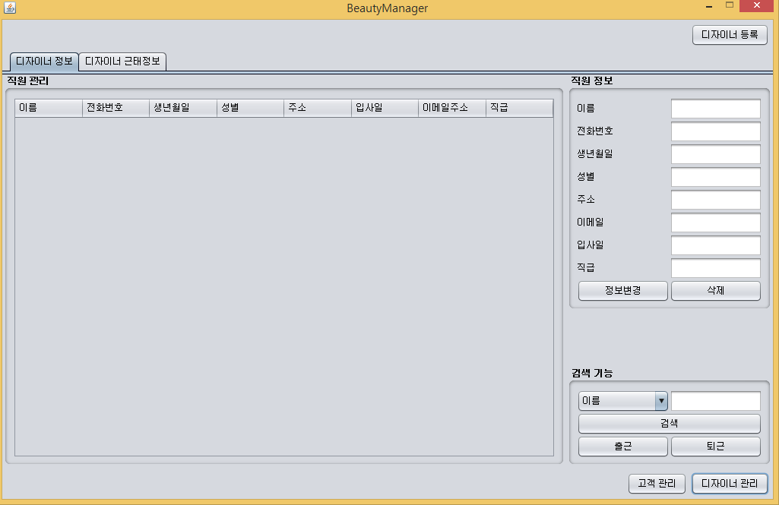
디자이너관리메인(BMDesignerMain)

Slide 8
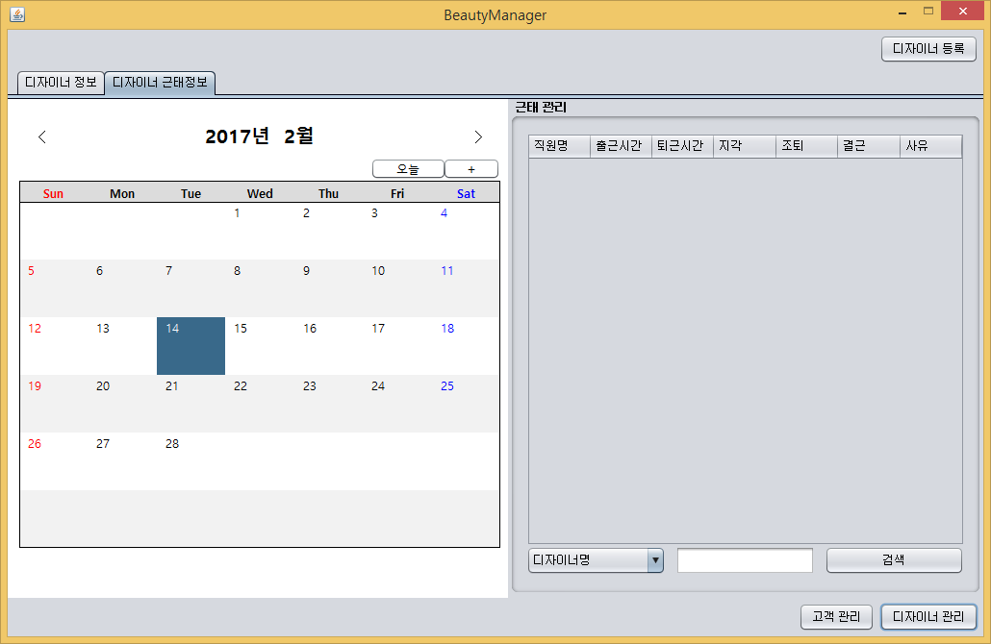
디자이너근태확인 Panel(BMDesignerAttend)

Slide 9
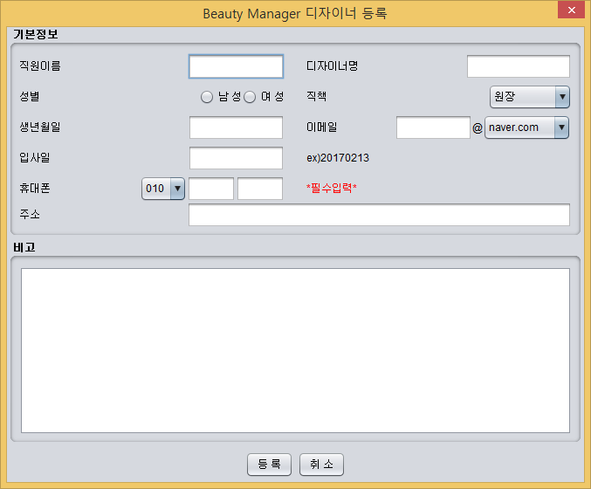
디자이너등록 화면(BMDesignerJoin)

Slide 11
BMLoginDlg
BMMain
ReceiveThread
BMDesignerMain
BMCustormerMain
BMCustomerInfo
BMCustomerDesign
BMCutomerJoin
BMDesignJoin
BMDesignerInfo
BMDesignerAttend
BMDesignerJoin

